Slide 1
DOCUMENT VERIFICATION SYSTEM USING BLOCKCHAIN
Presented By:
Mohamed Aslam A – 811720104060
Mohamed Jameer N - 811720104061
Rishikesh B – 811720104084
Subash Chandra Bose P - 811720104101
Guided By:
Mr. R.Rajavarman

Slide 2
CONTENTS
Objectives
Problem Statement
Existing Systems
Proposed System
System Requirements
Architecture
Modules
Implementation
Conclusion

Slide 3
OBJECTIVES
To provide a tamper-proof audit trail.
To reduce the risk of fraud and forgery.
To improve the efficiency and speed of the document verification.
To enhance trust and credibility in digital documents.

Slide 4
PROBLEM STATEMENT
Traditional document verification systems often suffer from issues related to trust, transparency, and security.
There is a lack of trust and transparency in the authenticity of the document verification process.
Traditional systems are vulnerable to fraud and data breaches, which can compromise the security of the system and the privacy of the users.

Slide 5
EXISTING SYSTEM
In existing, there is a need for a manual review process wherein a human/company reviews a document’s validity manually.
Here, they check by examining the physical characteristics, Compare the document to external tools and using specialized tools.
Manual document verification is subject to human error, human biases and not standardized.
It is less secure, less efficient and there is a chance of false negative.

Slide 6
PROPOSED SYSTEM
The proposed system allows automated document verification where a verified institution/company can export a document into system.
The system stores it in the IPFS database, generates a hash value and stores the hash value in the blockchain.
For checking, a user can upload the document into the system and system checks whether the hash value of the document is same as the hash value already stored in the blockchain.
If the hash value is same, then the document is valid.

Slide 7
SYSTEM REQUIREMENTS
HARDWARE REQUIREMENTS
SOFTWARE REQUIREMENTS
Processor – Intel i3 or Higher.
RAM – 4GB or Higher.
Storage – 150GB or Higher.
Operating System – Windows 7 or Higher.
Languages Used – HTML, CSS, Solidity.
Blockchain – Ethereum.
Tool – Metamask.
JavaScript Library – Web3.
Database – IPFS.

Slide 8
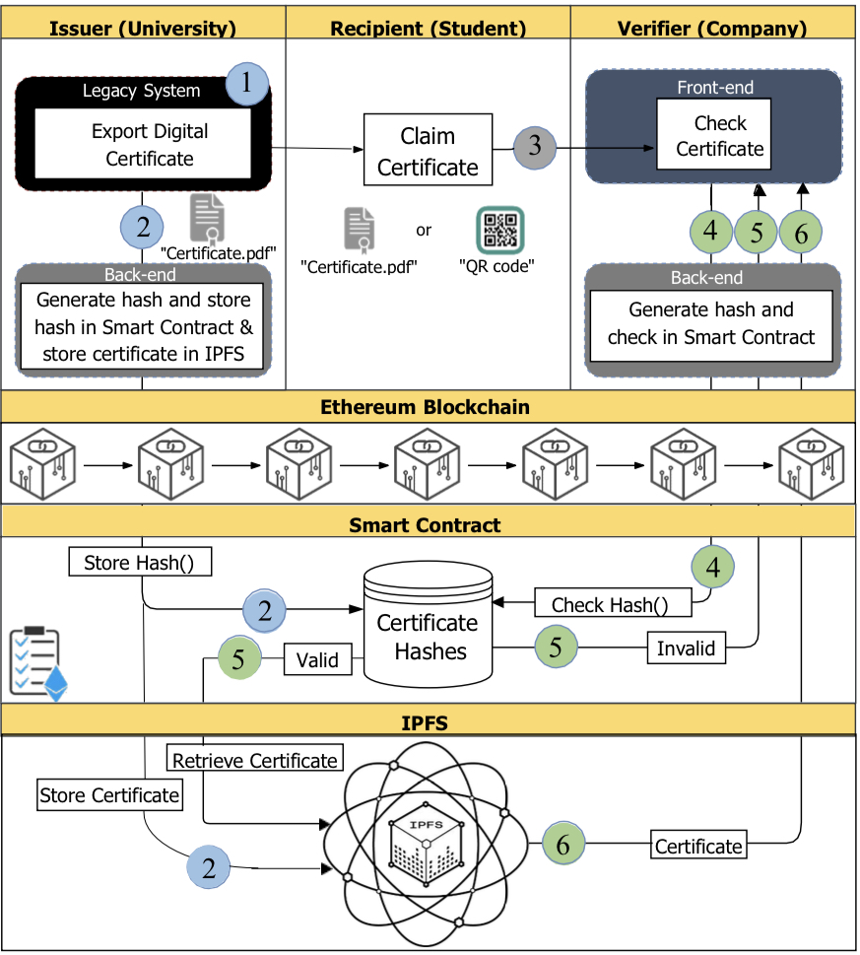
ARCHITECTURE

Slide 9
MODULES
UI design.
Admin Panel.
Upload Page.
Verification.
Deletion.

Slide 10
UI Design
The UI Design consists of five pages – Home, Upload, Verify, Delete, Admin.
Home is the index page of system which the user visits first.
Upload is the page to upload the document.
Verify is the page to verify the authenticity of the document.
Delete page is to delete the document.
Admin page is to control the overall system.

Slide 11
Admin Panel
The person who integrate the system with the blockchain has the Super Admin access.
Super Admin can add sub admins through their public key and the exporter name.
Admin has the rights to add, edit and delete the exporter(sub-admin).
With the public key, the sub-admin can upload the documents.

Slide 12
Upload Page
The upload page is dedicated to the process of exporting documents by the officials.
The process of exporting documents is done by selecting the document as a file through the “Choose File” entry, after which the document will be hashed directly.
Once you click on the “Upload Document" button, it will wait for confirmation or rejection of the transaction.
If the transaction is confirmed by pressing the "Confirm" button, the process of exporting the document will be completed successfully.

Slide 13
Verification
Organizations need to validate the applicant’s document, so they will visit the official website of the document provider for the purpose of verification.
Once the document file is uploaded (or through a QR code), the document will be hashed.
When the “verify” button is clicked, the system checks the document hash with the previously archived document hashes in the blockchain.
If it matches, the document is valid otherwise the document is invalid.

Slide 14
Deletion
The exporters have the authority to remove a previously exported document.
Through the “Choose File” entry, the document file is uploaded. Once the document file is uploaded, the document will be hashed.
When the “Delete Document" button is clicked, it will wait for confirmation or rejection of the transaction.
If the transaction is confirmed by pressing the "Confirm" button, the process of deleting the document will be completed successfully.

Slide 15
IMPLEMENTATION

Slide 16
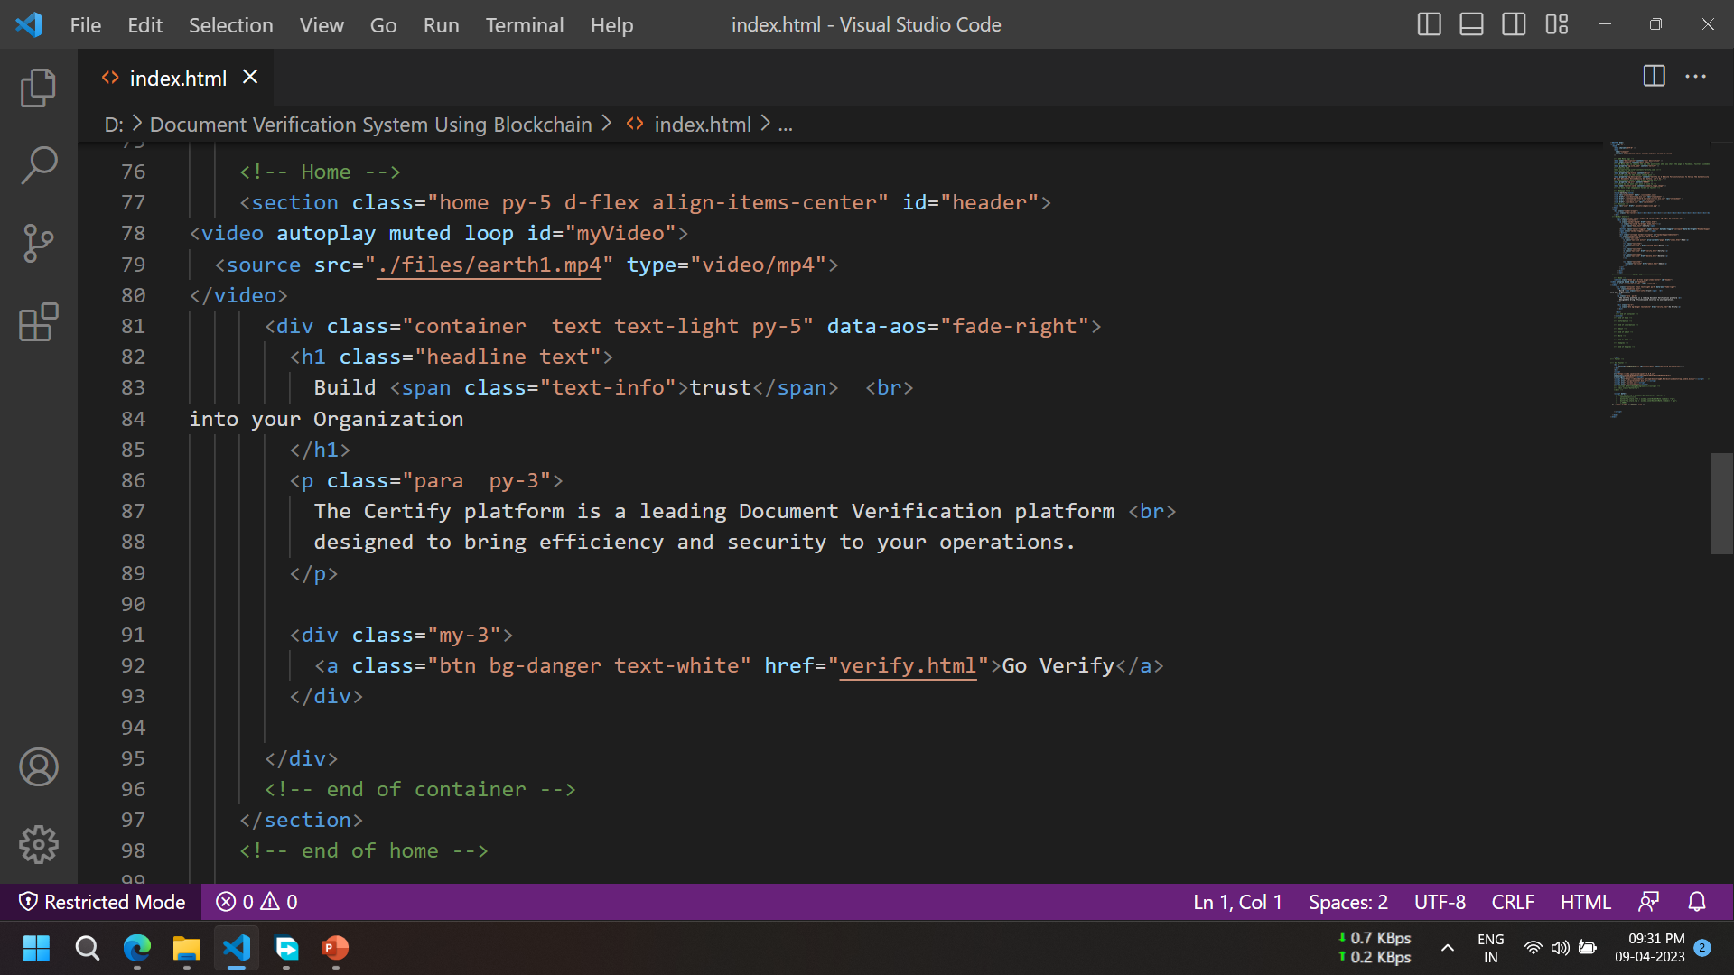
SAMPLE CODING

Slide 17
OUTPUT

Slide 18
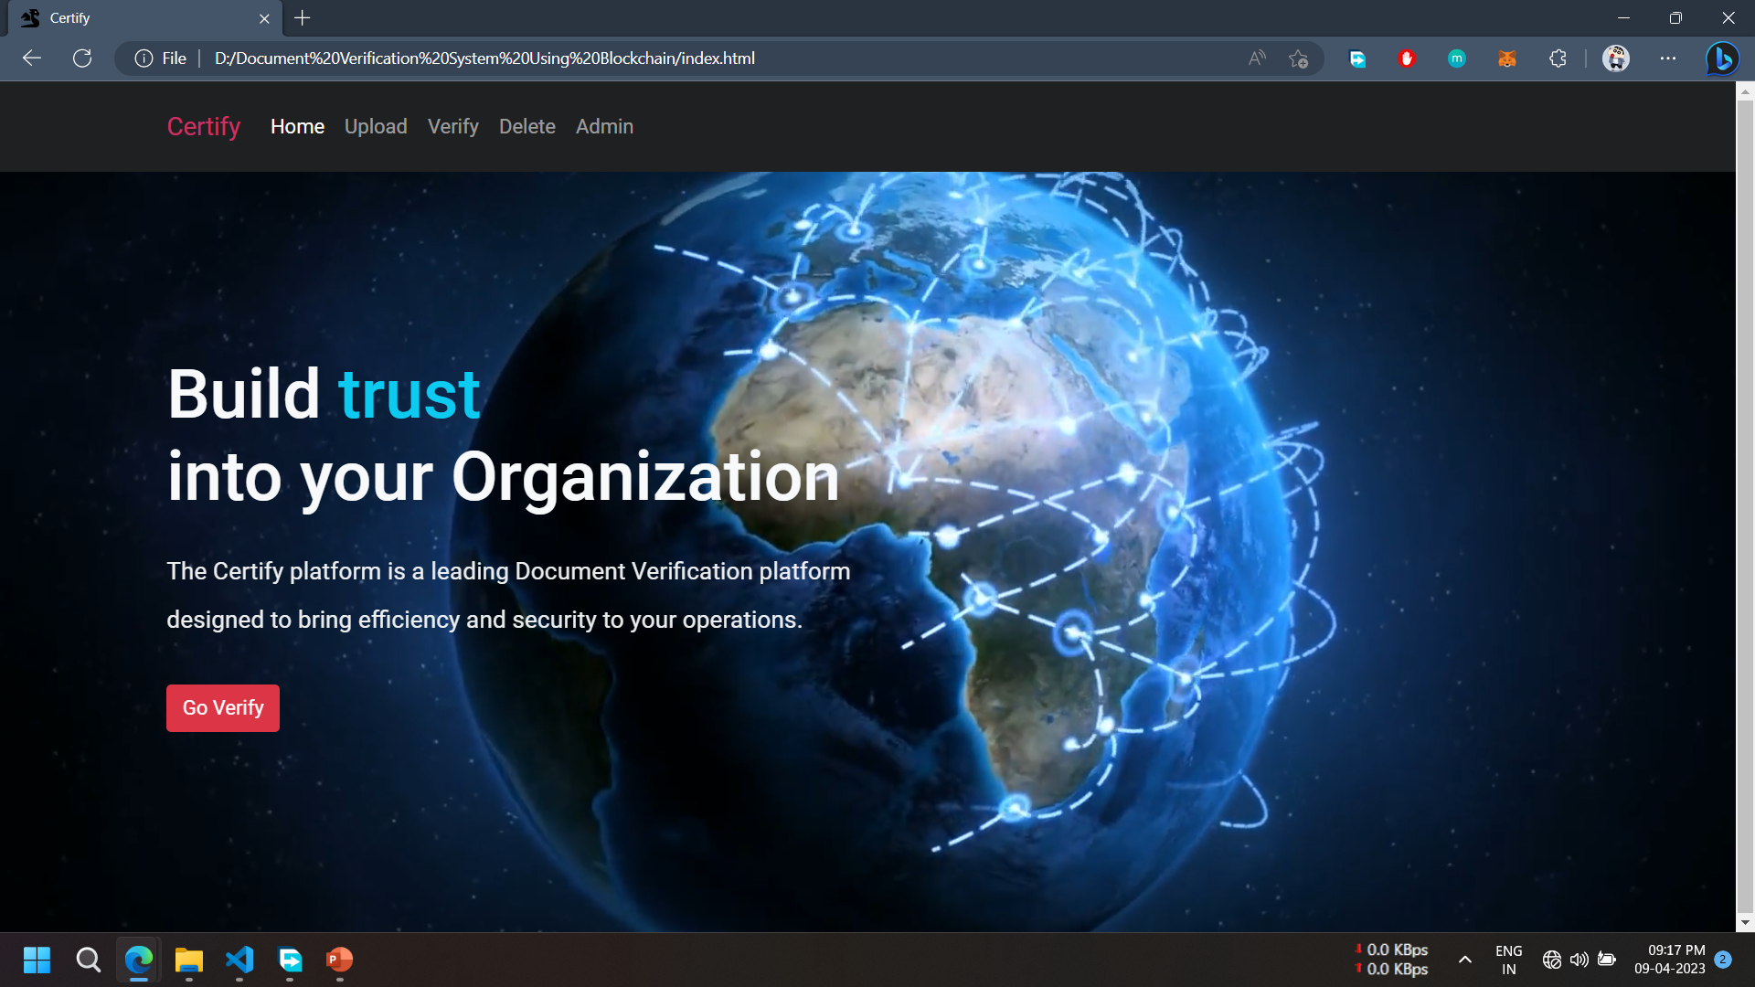
Module 1: UI Design

Slide 19
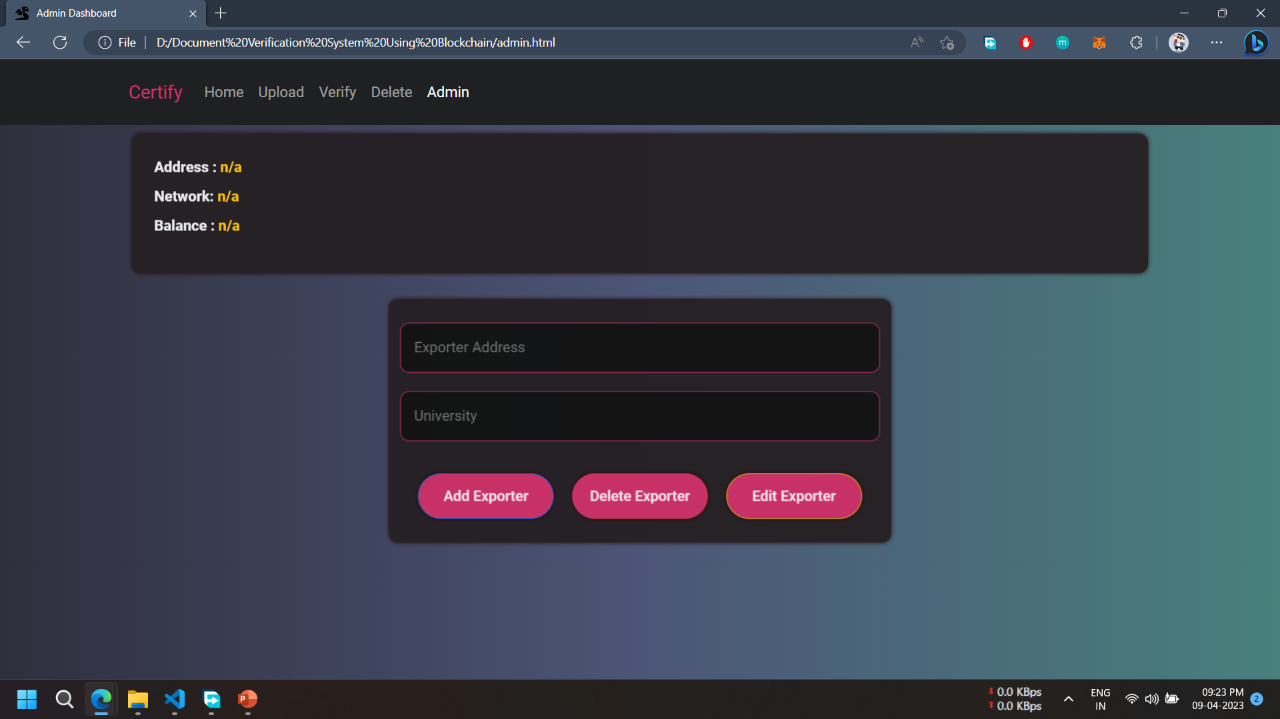
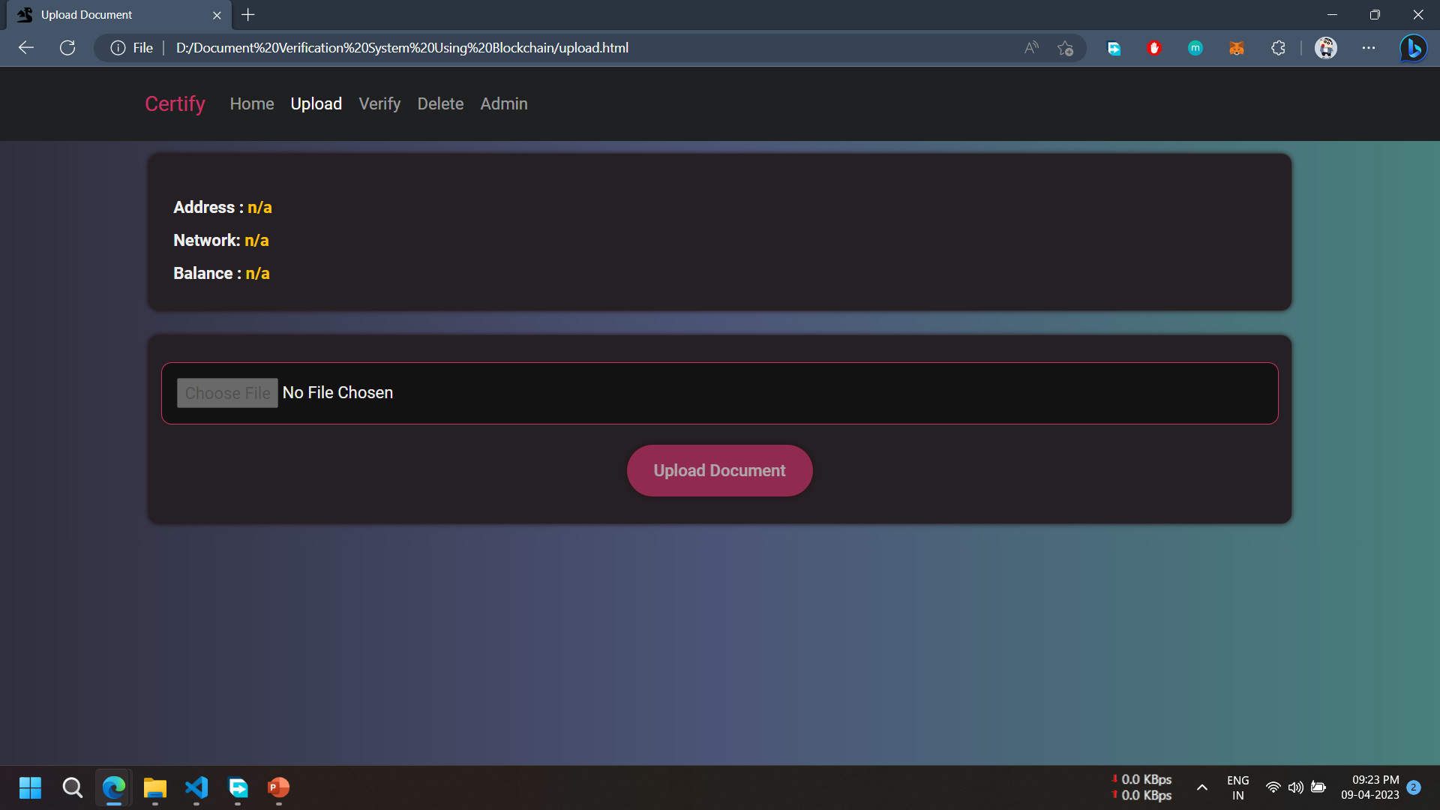
Module 2: Admin Panel

Slide 20
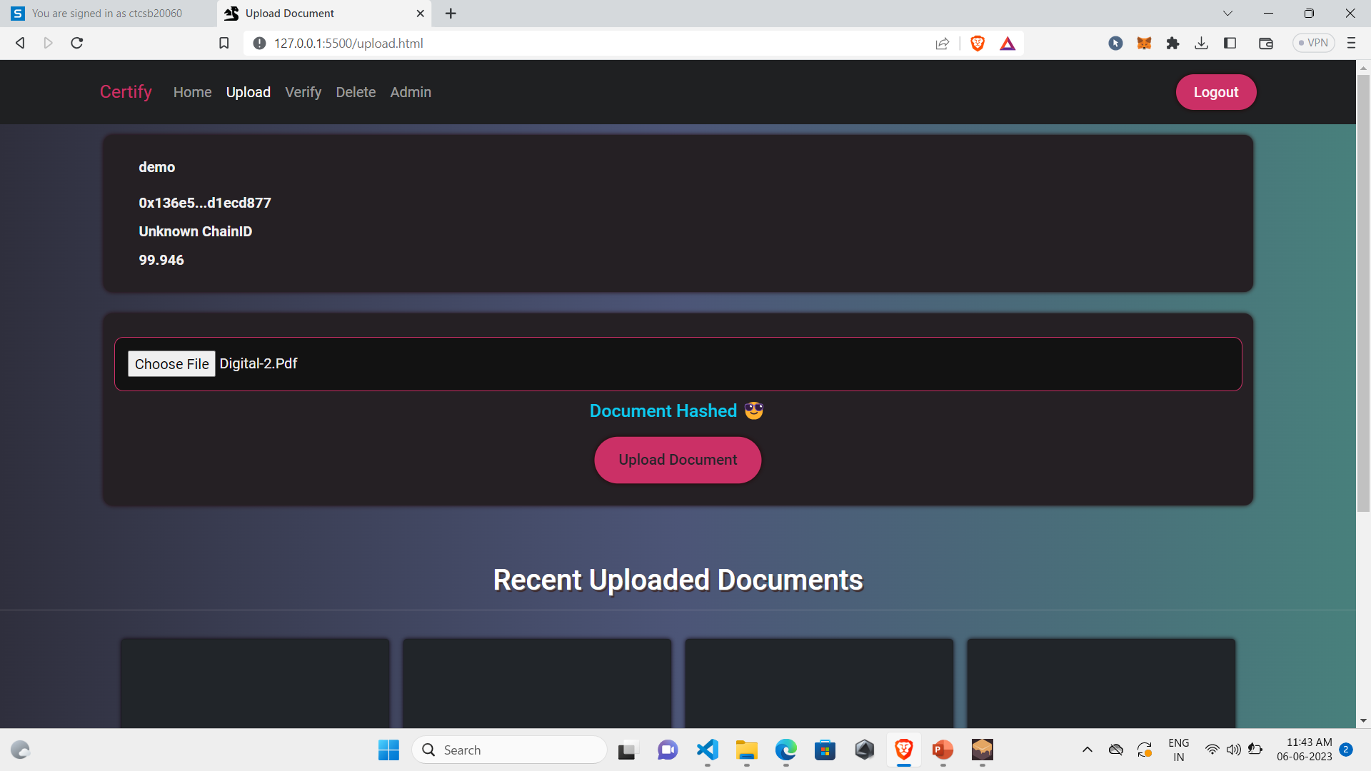
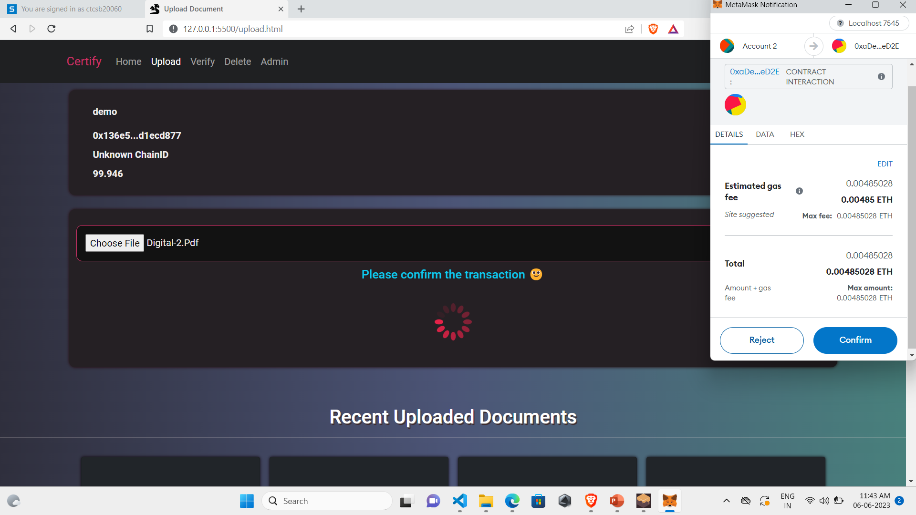
Module 3:Upload Page

Slide 21
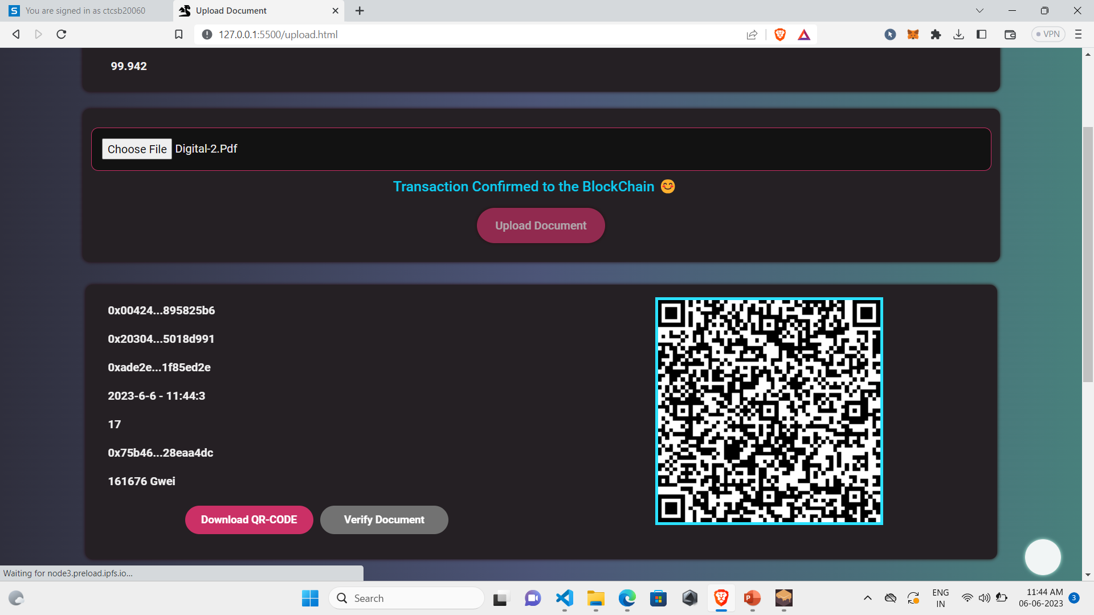
Module 3:Upload Page

Slide 22
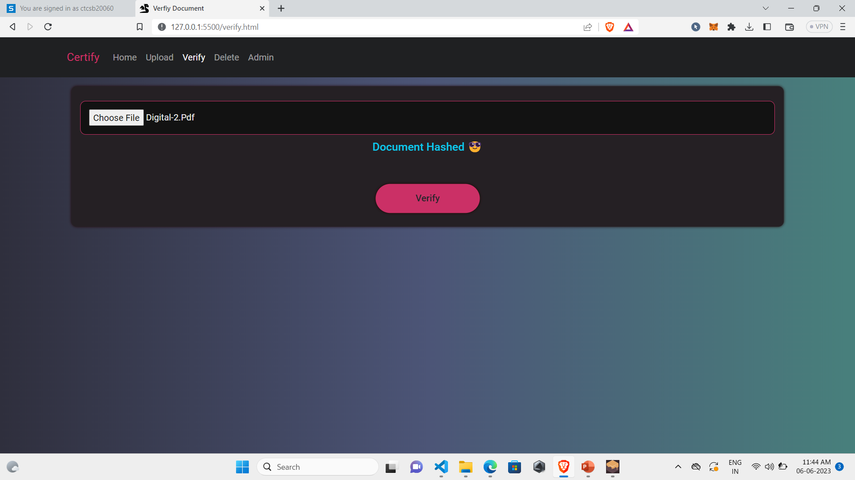
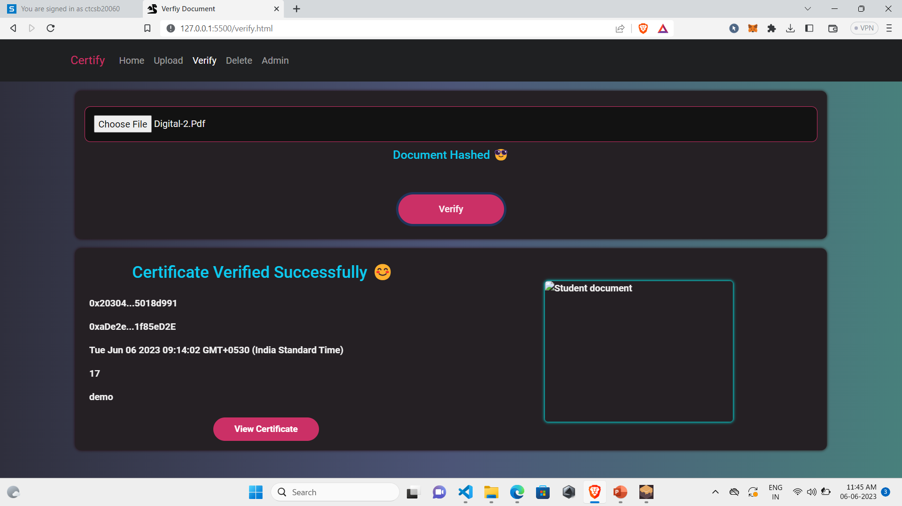
Module 4: Verification

Slide 23
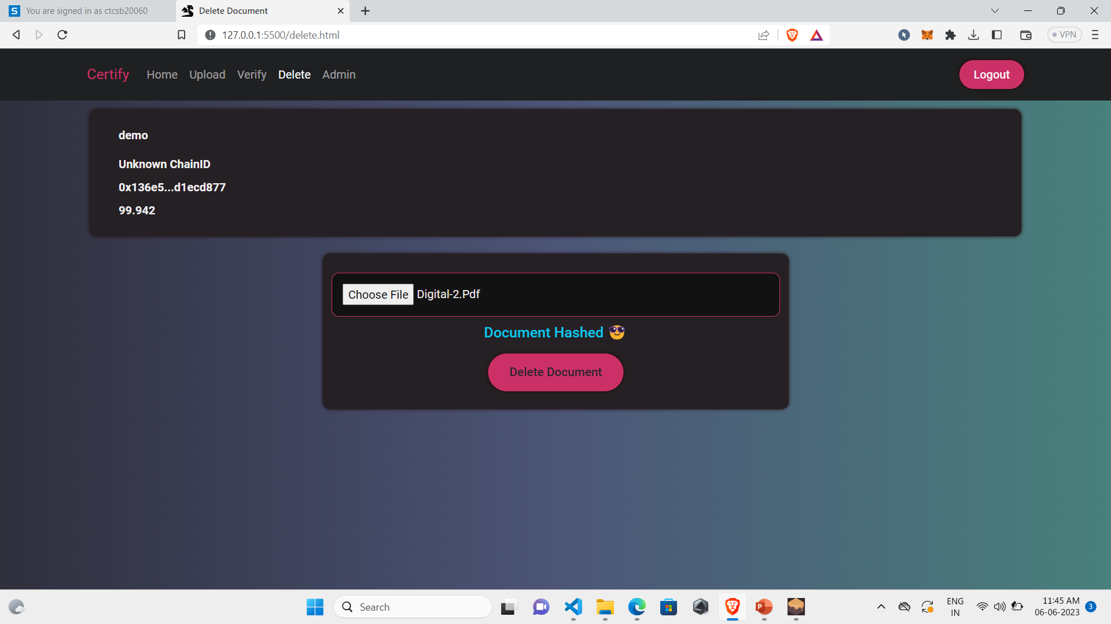
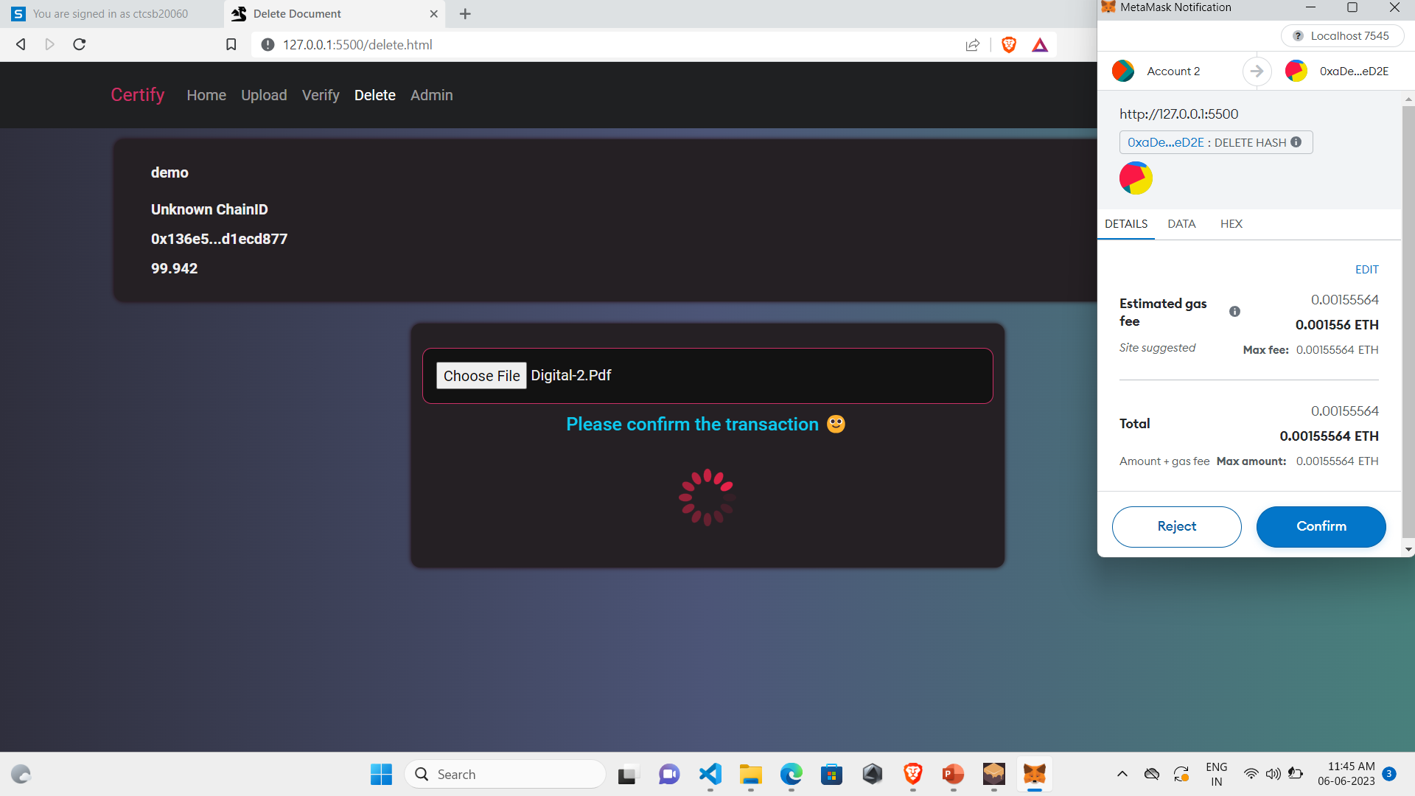
Module 5: Deletion

Slide 24
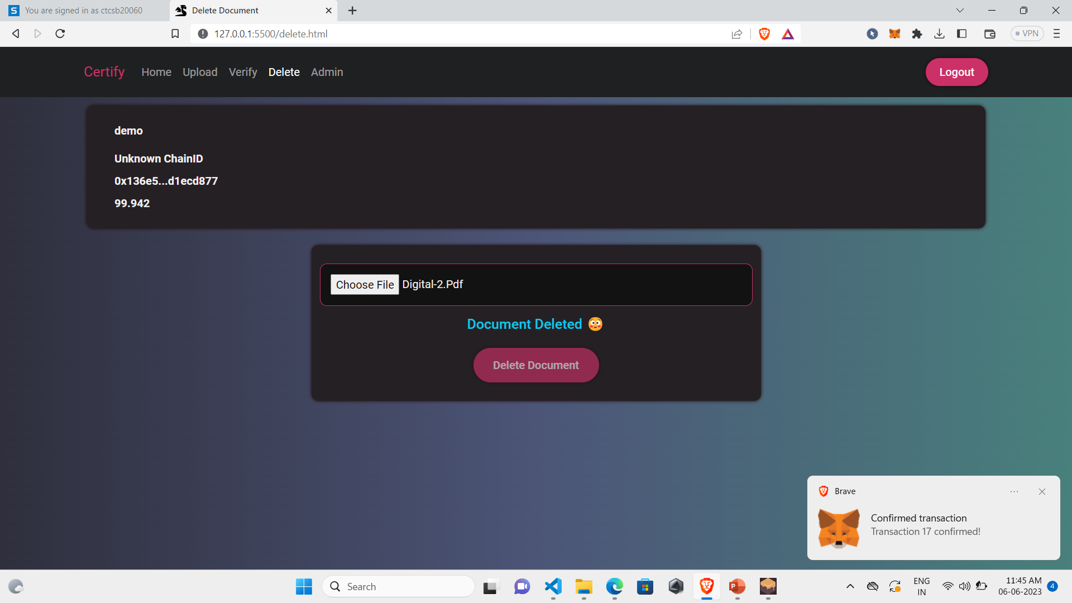
Module 5: Deletion

Slide 25
CONCLUSION
After making this project we assure that this project will help its users to check the validity of the document efficiently.
It will help them to verify the document in a secure and fast manner.
In short, this project will help its users to automate the whole document validation process.

Slide 26
REFERENCES
"Blockchain-Based Document Verification for Ensuring Data Integrity" by N. Parveen, A. T. Ngo, and H. T. Nguyen (2018)
"Secure Document Verification using Blockchain Technology" by R. D. Gawande, V. N. Nemade, and S. S. Suryawanshi (2019)
"Blockchain-Based Authentication and Verification of College Degrees" by K. Bhattacharya and S. Saha (2019)

Slide 27
THANK YOU

